Slide 1
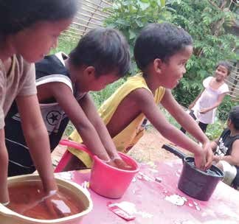
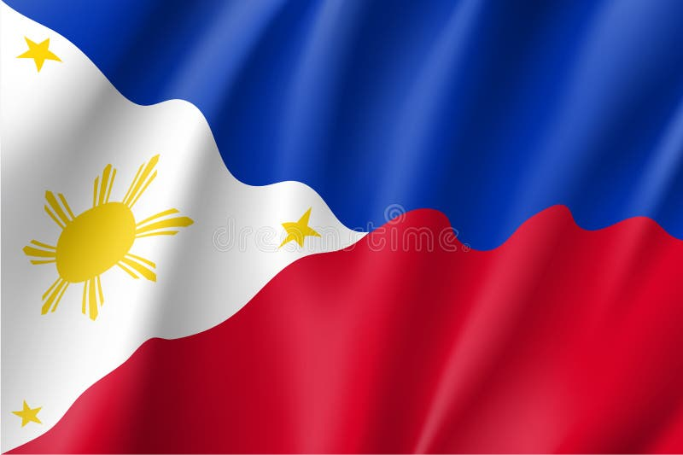
Week 12
PHILIPPINES
June 21
Scratch, Scratch,
Scratch
Little Boy

Slide 2
Little Boy felt so sad. His hands itched, his feet itched, and he didn’t know what to do to make the itching go away.
Little Boy and his family lived far away from any hospital. They lived far away from any doctors and nurses. They lived in a village high up in the mountains of the Philippines. The other boys and girls in the village also had itchy hands and itchy feet. No one knew what to do about it.
Then one day two young women came to the village. Little Boy heard them say that they were missionaries from far away. He heard them say that they would live for a year in his village. Then one of them looked directly at him and invited him to hear stories about God.
“Come to the mountain river that flows beside the village, and be sure to invite your friends,” she said with a bright smile.
Before long, Little Boy and a dozen other children were sitting on the rocky bank of the river with the two missionaries. Little Boy listened with interest as one missionary opened a book with colorful pictures and began to read a story about God. But then his hand began to itch. He scratched it. His foot began to itch. He scratched it, too. Then his other hand and foot itched, and he scratched them. The other children also felt itchy, and they all scratched and scratched and scratched. It was hard to listen to the story about God while they were scratching.
The missionaries noticed that the children were distracted by their itches, and they looked closely at their hands and feet.

Slide 3
“I have an idea,” said one of the missionaries. “I saw a similar rash when I was a small girl in my village. We boiled guava leaves in water, and then bathed our hands and feet in the water. Let’s try it here.”
The two missionaries asked the children if they had guava trees in the village. Little Boy eagerly pointed out a guava tree. The missionaries picked leaves and told the children to fetch basins or buckets or bowls at home. Little Boy scampered off.
When he returned, he found the missionaries boiling guava leaves in a large pot of water. Then the missionaries removed the pot from the fire and waited for the water to cool down. While they waited, the missionaries taught the kids happy songs about God. Then the missionaries poured water into the children’s basins and buckets and bowls. “Let’s pray to God for help,” one said. The other showed the children how to close their eyes and fold their hands. She prayed, “Dear God, please heal these children. In Jesus’ name, Amen.”
Little Boy and the other children put his hands into their containers and waited 20 minutes. Then they changed the water, put their feet in the containers, and waited another 20 minutes. The time flew by as they sang merrily about God.
Every day after that, the missionaries boiled leaves, prayed, and bathed the children’s hands and feet. They showed all the mommies how to do the same. After two weeks, the white bumps left the children’s hands and feet. Everyone was so happy!
Then the missionaries invited the children to come back to the riverbank to hear stories about God. Little Boy went. Now he could listen attentively because he was no longer distracted by itchy hands and feet. He wanted to know more

Slide 4
about the God who had heard the missionaries’ prayers and healed him.
The two young women who helped Little Boy were trained to be missionaries at a center built with the help of a Thirteenth Sabbath Offering in 1986. Thank you for planning a generous Thirteenth Sabbath Offering on June 28 that will help more children know about Jesus in Asia.
By Andrew McChesney

Slide 5
