Slide 1
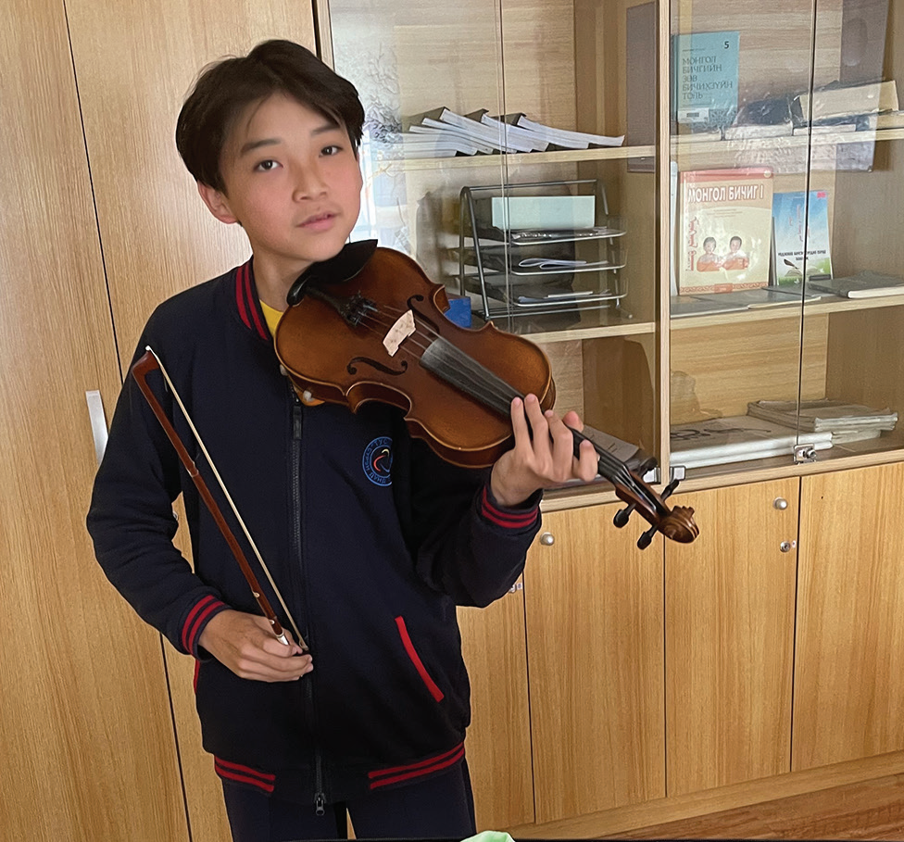
Week 1
MONGOLIA
January 4
Happy
Butterflies
Tamir

Slide 2
Five-year-old Tamir [ta-MIR] was bored. He was waiting for Mom to finish her work at the Seventh-day Adventist school in Mongolia. Mom worked as an accountant, which meant she counted money for the school. Tamir went to the school’s preschool. Now his classes were over, and he was sitting on a chair, waiting to go home.
“Mommy, can I have your phone?” he asked.
Mom handed the phone to the boy. His eyes stopped on an app with a picture of a man with wavy white hair and a red jacket.
“Mommy,” he said, “who is that?”
“That’s Mozart,” Mom said.
“Wow,” Tamir said. “He’s so handsome.”
Mom smiled. She opened the app and pressed “play” on a song written by the famous Austrian composer Wolfgang Amadeus Mozart. Tamir’s eyes opened wide with amazement as violin and piano music filled the room. It was beautiful! Happy butterflies filled his tummy.
Tamir couldn’t stop thinking about the music. Two days later, he told Mom and Dad that he wanted to learn to play the violin and the piano. Dad shook his head. “We don’t have money for music lessons,” he said.

Slide 3
Tears came to Tamir’s eyes. He wanted to play the violin and piano, and he didn’t give up. He asked again the next year when he was 6 years old. He asked when he was 7 and then 8. He asked when he was 9 and then 10. He asked when he was 11 and then 12. Every time, Mom and Dad shook their heads. But Tamir didn’t give up. He asked again when he was 13.
This time, Mom and Dad didn’t shake their heads.
“I’ll take you to violin lessons tomorrow,” Mom said. She had a friend who would teach the violin to Tamir.
Tamir was so happy! His smile stretched from ear to ear. Happy butterflies filled his tummy. He excitedly told his friends.
They were surprised. “Are you really going to play the violin?” one boy asked.
“Yes!” he replied. “I’m going to learn the violin tomorrow!”
“Wow!” said another boy. “You’re going to be famous one day!”
Learning the violin wasn’t easy. It was difficult to learn the notes. Sometimes Tamir wanted to play with friends, but he had to practice. He didn’t mind. He wanted to fill his tummy with happy butterflies.
A year passed, and Tamir kept practicing. Then he was asked to play for special music at church. Mom was so happy!

Slide 4
On Sabbath morning, she excitedly told everyone, “My son is playing the violin up front today.”
But Tamir wasn’t so happy. His hands began sweating. His neck began sweating. His face began sweating. He was scared about playing in front of a crowd. He thought, “No, no, no! I don’t want to play the violin anymore. I want to go home.”
Dad saw that the boy was nervous. “Don’t worry,” he said. “Jesus will help you.”
Tamir knew that Dad was right. He wondered why he hadn’t thought about that first. He silently prayed, “God, please help me not to be scared of the people when I play the violin. Please bless me.”
Then he played in front of all those people. He wasn’t scared. His face wasn’t sweating. His neck wasn’t sweating. His hands weren’t sweating. Happy butterflies filled his tummy. He felt good! When he finished, everyone was so happy.
“Wow, you are a good player,” someone said.
“One day, you’ll be famous,” someone else said.
Tamir knew that God had helped him.
To play well, Tamir needs to practice every day, and he needs to pray every day. Tamir wants to represent Mongolia and God before the world. He wants happy butterflies in fill his tummy all the time.

Slide 5
Pray that Tamir will be a good representative of God as he learns the violin and studies at Tusgal School in Ulaanbaatar, Mongolia. His school received part of a previous Thirteenth Sabbath Offering to grow with new classrooms and a library. This quarter’s Thirteenth Sabbath Offering will help open a children’s recreation center in Ulaanbaatar, where children will be able learn about the God who answers prayers.
By Andrew McChesney

Slide 6
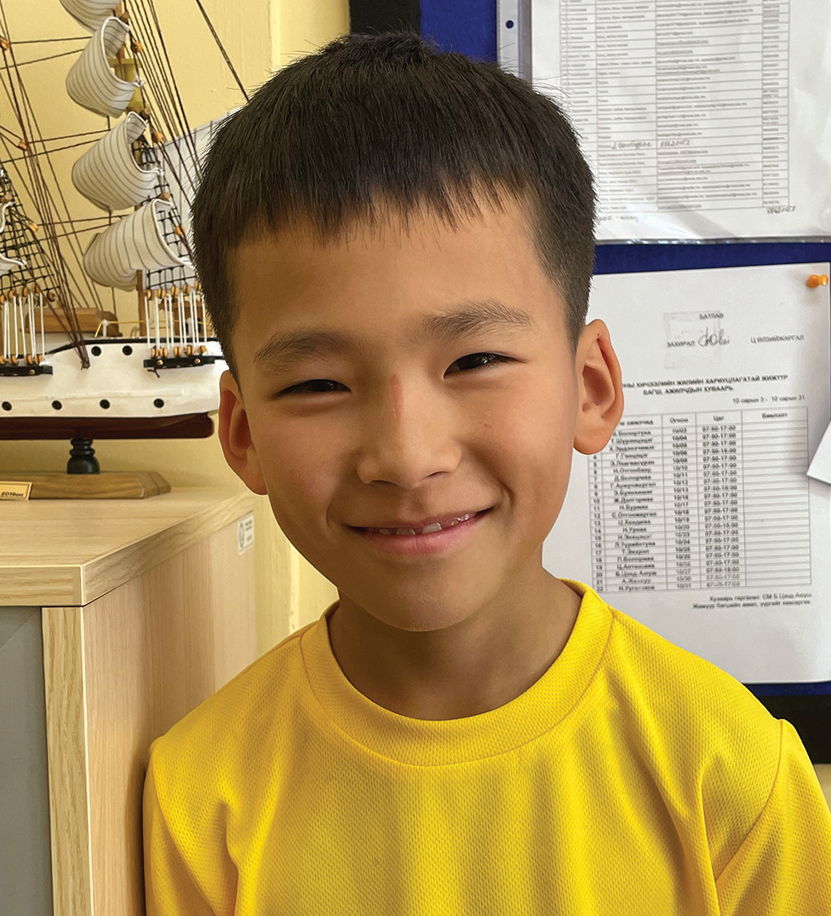
Week 2
MONGOLIA
January 11
Prayer of
Faith
Itgel

Slide 7
Itgel [IT-gil] is a 10-year-old boy in Mongolia. His name, Itgel, means “faith” in the Mongolian language. Itgel has a lot of faith.
When the school year began, Itgel was excited to return to the Seventh-day Adventist school where he studied in Ulaanbaatar, the capital city of Mongolia. He was ready to start fourth grade.
But his joy lasted only for a week.
At the end of the first week of school, all of the boys and girls got together for a special sports day. Itgel enjoyed being outdoors. It was fun to be out in the open air. He ran and ran and ran as fast as he could.
That night, however, Itgel didn’t feel well. His legs hurt terribly. He could barely move. Mom was worried, and she put a hand on his forehead. He was burning up with fever. Mom and Dad took the boy to the hospital.
When the doctor saw Itgel’s high fever and heard about the pain in his legs, he also was worried. He pulled out a syringe and gave Itgel a shot. Itgel had to stay at the hospital.
That night, Itgel tried to fall asleep, but it was hard to sleep when he felt so hot and his legs hurt so much.
He prayed in his heart, “God, please heal me quickly.”
In the morning, the doctor gave Itgel another shot. At noon, he gave him a third shot.

Slide 8
Itgel began to feel a little bit better. But he still couldn’t walk. His legs hurt and felt so weak. The doctor told him not to try to stand up. A nurse helped him sit in a wheelchair so he could go around the hospital.
Itgel was happy for the wheelchair, but he wanted to walk. He wanted to go back to school. He already missed his friends. He prayed in his heart, “God please heal me quickly. I want to start walking on my own. I want to go back to school to see my friends.”
He didn’t know when he would be able to go home, but he believed that God would heal him. He decided to keep praying. When he woke up the next day, he immediately prayed, “God please heal me quickly. I want to start walking on my own. I want to go back to school to see my friends.”
When the doctor came to help him, he prayed, “God please heal me quickly. I want to start walking on my own. I want to go back to school to see my friends.”
When he went to bed at night, he prayed, “God please heal me quickly. I want to start walking on my own. I want to go back to school to see my friends.”
For two weeks, Itgel prayed.
One day, the doctor said, “Let’s see how you’re doing.”
He looked at the boy, gave him a shot, and said, “You’re well! You can go home.”

Slide 9
Itgel was so happy! A big smile filled his face. God had answered his prayers.
When Itgel returned to school, his friends had many questions. They had missed him.
“What happened?” one boy asked.
“I was really sick,” Itgel said.
“How did you get well?” asked another boy.
“God healed me,” Itgel said. “I was really sick, but now I’m well because I prayed.”
Some of Itgel’s friends didn’t come from Christian homes and didn’t believe in God.
“What?” said one boy. “It’s just pure luck that you got well.”
“No way,” said another. “You aren’t telling the truth.”
Itgel wasn’t surprised. He wasn’t upset. He knew that his friends didn’t understand because they didn’t know God. But he knew God, and he knew that God had healed him.
“You can say whatever you like, but it’s true,” he said. “God healed me.”

Slide 10
Itgel wants his friends to know God. Ever since his sickness, he hasn’t stopped telling them about Him.
Itgel’s name means “faith,” and he intends to always have faith in God. “Even though some of my friends don’t believe in God, I still believe in Him,” he said. “I saw that He healed me.”
Pray for Itgel and his friends at Tusgal School in Ulaanbaatar, Mongolia. A previous Thirteenth Sabbath Offering went to help his school grow with new classrooms and a library. This quarter’s Thirteenth Sabbath Offering will help open a children’s recreation center in Ulaanbaatar, where children will be able learn about the God who answers prayers.
By Andrew McChesney

Slide 11
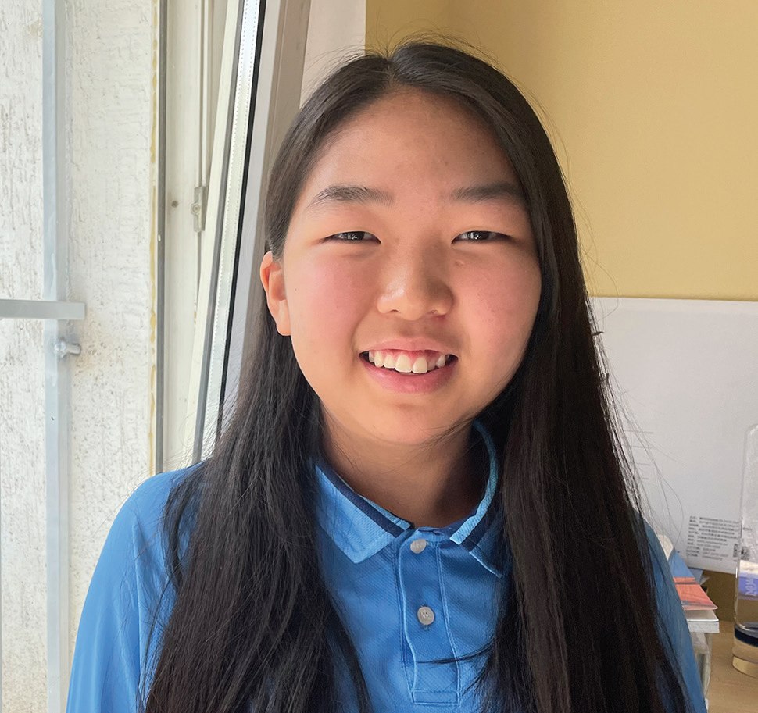
Week 3
MONGOLIA
January 18
The Biggest
Decision
Michelle

Slide 12
Thirteen-year-old Michelle was talking with her best friend, Enkhjin, [INKH-zhin] at a Pathfinder club meeting, and Enkhjin told her that she planned to get baptized on Sabbath.
“Don’t you want to get baptized together?” she asked.
Michelle thought to herself, “Should I get baptized, or should I wait? Maybe I’ll ask Mom when I get home.”
Out loud, she said, “I don’t know.”
Enkhjin looked disappointed. The two girls had learned about Jesus in Pathfinders together. They had studied the Bible together. Now Enkhjin wanted to give her heart to Jesus in baptism, and she wanted Michelle to join her. She looked sad, but out loud she said only, “OK, OK.”
Michelle decided to talk with Mom.
When she returned home, she first went to her bedroom to change out of her Pathfinder uniform. In her bedroom was her older cousin, whose name was also Enkhjin.
“I’m going to get baptized on Sabbath,” Enkhjin said. “Why don’t we get baptized together?”
Michelle was so surprised! In one day, two girls named Enkhjin had told her that they planned to be baptized. In one day, two girls named Enkhjin had asked her to be baptized.

Slide 13
Now she really wanted to talk to Mom.
“I need to talk with Mom,” she said.
Enkhjin looked disappointed. They had studied the Bible together. That summer, they had gone to evangelistic meetings every night at their church together. Now she wanted to give her heart to Jesus in baptism, and she wanted Michelle to join her.
Michelle found Mom. She didn’t tell her about the conversations with Enkhjin or Enkhjin. She just asked, “Should I get baptized next Sabbath?”
Mom looked thoughtful. Dad was away from home for work, and she knew that he wouldn’t want to miss his daughter’s baptism. “Dad is away, so he wouldn’t be able to see it,” she said. “Why don’t you get baptized at the big Pathfinder camporee in South Korea instead?”
In a few weeks, Michelle planned to go to South Korea for a camporee of Pathfinders from all over Mongolia and other countries.
But Mom’s idea didn’t make sense to Michelle. Neither Dad nor Mom planned to go to the camporee. If she waited, neither of them would see her baptism. At that moment, she knew what decision she had to make. If she didn’t give her heart to Jesus next Sabbath, there would always be an excuse for waiting until later. She loved Jesus with all her heart, and she wanted to give it to Him. She told Mom, “I’d better get baptized here and now.”

Slide 14
Mom smiled. “Well, go ahead and get baptized then,” she said.
Michelle’s cousin Enkhjin was so happy when she heard that they would be baptized together. Michelle’s best friend, Enkhjin, was so happy when she heard that they would be baptized together.
On Sabbath, the girls got on a bus and rode to a river with other people who were going to be baptized.
Right before Michelle entered the river, a question popped into her head.
“Am I really ready?” she thought. “Is this really my decision?”
She remembered how her best friend had asked her to get baptized. She wondered, “Am I getting baptized because Enkhjin asked me?” She remembered how her cousin had asked her to get baptized. She wondered, “Am I getting baptized because the other Enkhjin asked me?” She remembered how Mom had suggested that she wait. Then she remembered how much she loved Jesus and how she wanted to live for Him today and forever. She got baptized with a happy smile.
Afterward, many people congratulated Michelle on her decision.
“You have made the most important decision of your life,” someone said.
Today, Michelle is so happy that she got baptized. She could have waited and kept saying, “Tomorrow, tomorrow,

Slide 15
tomorrow.” But instead, she decided to make the biggest decision of her life on that summer day.
“I always knew that I wanted to give my heart to Jesus, but I didn’t know when the right time was,” she said. “Now I know that the right time was not tomorrow but today.”
Michelle is a student at Tusgal School in Ulaanbaatar, Mongolia. A previous Thirteenth Sabbath Offering went to help her school grow with new classrooms and a library. This quarter’s Thirteenth Sabbath Offering will help open a children’s recreation center in Ulaanbaatar, where more children will be able learn about God.
By Andrew McChesney

Slide 16
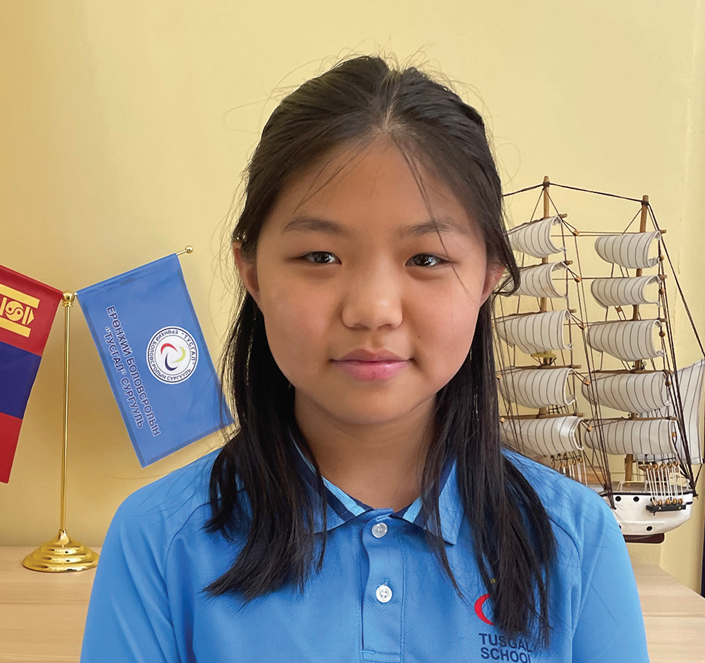
Week 4
ALASKA
January 25
Bullied Missionary Kid
Ninjin

Slide 17
When Ninjin [nin-GIN] was 8, she and her parents moved far away from their home in Mongolia to live as missionaries in a foreign land.
Ninjin was excited to move. She couldn’t wait to make new friends. But the first day at her new school was hard. She didn’t understand a word that anyone said. She just sat at her desk and was quiet. The next day, Ninjin decided to make new friends. She introduced herself to the other children by pointing to herself and saying her name, “Ninjin, Ninjin.” A month passed, and Ninjin was able to talk a little bit with the other children. But it seemed like the other children didn’t really want to talk with her.
One day, the teacher told all the children to take turns reading out loud from a textbook.
When Ninjin began to read, the girl in front of her turned around with an angry face.
“You’re talking too loud,” she said. “Shh!”
The other children tittered.
Ninjin didn’t understand what the girl said. When it was her turn to read again, she read just as loudly as the first time.
The girl again scowled and hissed, “Shh!” The other children giggled. Ninjin didn’t understand and kept on reading.

Slide 18
Then the girl picked up a stick of glue and threw it at Ninjin. The glue hit her on the head, and the children laughed. The angry girl stood up and hit Ninjin.
Ninjin was shocked. She looked over at the teacher, who was sitting at her desk. The teacher was looking at the textbook and didn’t seem to notice anything.
When Ninjin went home, she told Mom what had happened. Mom went to school and spoke with the teacher.
The teacher didn’t believe Ninjin’s story. She said that the girl sitting in front of Ninjin would never act unkindly to anyone.
“She’s a very sweet girl,” she said.
Ninjin realized that the teacher wouldn’t help her, but she was sure God would help her. She decided to pray.
A few days later, Ninjin was changing out of her school clothes after school and found glue all over the back of her skirt. The skirt was ruined. She wondered how the glue had gotten there. When she went to school the next day, she found dried glue smeared on her chair. She realized that someone must have poured glue on her chair and that was how it got onto her skirt.
She told Mom, and Mom spoke with the school principal. A security camera in Ninjin’s classroom had recorded the whole thing. Ninjin watched the video recording. It showed Ninjin leaving the classroom to go to the restroom. It showed several girls rubbing glue all over her chair. Ninjin could see their faces.

Slide 19
At that moment, Ninjin felt very lonely. It was hard being a missionary kid in a country where she didn’t know the language and no one seemed to want to be her friend. She missed Mongolia.
After that, Ninjin didn’t want to go to school anymore. But she had to go. There was no other school. Ninjin prayed.
Two months later, Mom said they were moving back to Mongolia. The family couldn’t get new visas, allowing them to stay. The missionaries had no choice but to leave.
“This must be God’s will,” Dad said.
Today, Ninjin is 12 years old, and she has forgiven the kids who bullied her.
“At first, I couldn’t forgive them,” she said.
But then she remembered what Jesus teaches about forgiveness. He said, “For if you forgive men their trespasses, your heavenly Father will also forgive you. But if you do not forgive men their trespasses, neither will your Father forgive your trespasses” (Matthew 6:14, 15; NKJV). That means Jesus cannot forgive the sins of anyone who refuses to forgive others.
“After talking to God several times, I remembered that He has forgiven me for all my sins,” Ninjin said. “So, I realized that I have to forgive those bullies, too.”

Slide 20
She is glad that she had the bad experience. She is more sensitive to kids who are picked on for being weaker or not knowing the language. She gently confronts unkind children, saying, “That kid you’re picking on has feelings, too. Please be kind.”
“I’m really thankful that God blessed me with this school and this country and the experience that He gave me as a missionary kid,” she said. “I just thank Him that I have Him beside me.”
Ninjin studies at Tusgal School in Ulaanbaatar, Mongolia. A previous Thirteenth Sabbath Offering helped her school grow with new classrooms and a library. Thank you for your Thirteenth Sabbath Offering this quarter that will help open a children’s recreation center in Ulaanbaatar.
By Andrew McChesney

Slide 21
Week 5
MONGOLIA
February 1
Sticking Out Ears
Javkhaa

Slide 22
Javkhaa’s [JAV-khaa] ears stuck out. His ears stuck out really far. He didn’t think anything about his ears until other boys began to tease him — and he didn’t like it.
Now there was nothing wrong with Javkhaa’s ears. Many boys have ears that stick out, but not at Javkhaa’s school in Mongolia. The other boys began teasing the 8-year-old boy.
When school finished every day, he knew that he had to go straight home. Mom didn’t want him hanging out with the other boys because they used bad words and did naughty things.
Javkhaa didn’t have many friends, and he wanted the other boys to like him. He wanted them to be his friends. So, one day he ignored Mom’s instructions and followed five big boys instead of going home.
The boys didn’t want to be Javkhaa’s friends. Instead of being happy that he was with them, they began to tease him about his ears.
Javkhaa was sad. He wondered if he was ugly. Then one of the boys called him a bad name. He didn’t like that at all. He raised his fist and hit the boy.
The five boys jumped on him, like five angry bears pouncing on a small lamb. They hit him and kicked him and ran away.
Javkhaa lay on the ground and cried. He wished that he had obeyed Mom and gone home straight from school.

Slide 23
Standing up, he walked over to a nearby bench and sat down. Then he remembered God. He bent over on the bench, one hand clutching his stomach, which hurt. He closed his eyes and prayed, “Our dear Lord, thank You for always being with me. Thank You for always hearing me. Please hear me now. Help me to have friends who don’t tease me. Help me to have friends who are a good influence. Amen.”
Getting up, he ran home as fast as he could. When he got near the house, he dusted off his clothes so Mom wouldn’t see that he had been in a fight. He tried to look happy as he walked into the house.
Mom didn’t notice anything wrong. “Wash your hands, and eat your supper,” she said.
After eating, Javkhaa went to his bedroom and changed his clothes. He thought about the day. “Why did they beat me up?” he wondered.
Javkhaa didn’t talk to those boys for the next week, and they didn’t talk to him. Then, one by one, the boys came to him to say that they were sorry.
Javkhaa forgave them, but he didn’t hang out with them after school anymore. He realized that Mom was right. The boys used bad words and did naughty things. When he was with them, he also wanted to use bad words and do naughty things. They were a bad influence. He wanted friends who were a good influence. He prayed for friends.
Two years later, Javkhaa’s family moved from their small town in the Gobi Desert to Mongolia’s capital, Ulaanbaatar. Javkhaa started studying at the Seventh-day Adventist school in the city. He was so happy!

Slide 24
No-one made fun of his ears. Instead, his new classmates spoke kind words and did good things. They were a good influence on him, and he could be a good influence on them. He made many good friends.
“God gave me friends just as I prayed,” Javkhaa said. “I think one of the biggest blessings in my life is to go to this school.”
Today, Javkhaa is 14 and studies at Tusgal School in Ulaanbaatar, Mongolia. A previous Thirteenth Sabbath Offering helped his school grow with new classrooms and a library. This quarter’s Thirteenth Sabbath Offering will help open a children’s recreation center where children will learn to speak kind words and do good things in Ulaanbaatar. Thank you for your support.
By Andrew McChesney

Slide 25
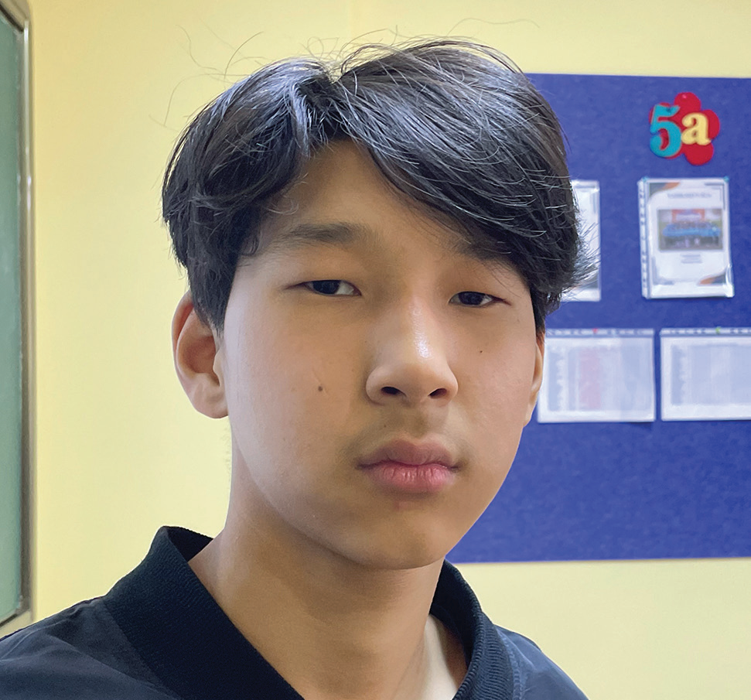
Week 6
MONGOLIA
February 8
A Tale of
Two Schools
Anar

Slide 26
When Anar was old enough for first grade, he started going to the Seventhday Adventist school in Mongolia’s capital, Ulaanbaatar. His family wasn’t Adventist, but his mom decided that Tusgal School was the best place for him. Then Mom and Dad moved to the United States to work and left Anar with an aunt.
Anar liked the Adventist school and his classmates. The teachers enjoyed teaching, and the children enjoyed learning and playing. He finished first grade. Then he finished second grade, third grade, fourth grade, fifth grade, and sixth grade. He enjoyed everything about the school. Everyone treated him kindly.
Then a new boy showed up in the seventh grade. The new boy was named Batu, and he didn’t treat Anar kindly. Batu made fun of the way that Anar walked. He made fun of the way that Anar talked.
Now Anar didn’t walk and talk like the other boys and girls at the school. For him, it was difficult to put one foot in front of the other. He has cerebral palsy. Part of his brain didn’t grow normally while he was still a baby inside his mother. As a result, when he walked, he sometimes stumbled. He also didn’t talk as quickly as his classmates. When he spoke, the words came out very slowly.
Batu liked to tease Anar. Even though Anar asked him to stop, he didn’t.
Anar spoke with his teacher, and the teacher spoke with Batu. After that, everything was fine for a while, but then Batu started to tease again.
After a while, the school social worker got involved, and Batu stopped his teasing, but only for a while.

Slide 27
One day, Batu called Anar a bad name, Anar tried to hit him. But Batu was bigger, faster, and stronger, and he won the fight.
Afterward, the school organized a meeting between Batu’s parents and Anar’s aunt.
But Anar had had enough. He told his aunt that he wanted to transfer to another school.
Anar liked his first day in public school. No one spoke unkindly to him.
But on the second day, the other boys began to notice that he didn’t walk and talk like them. They began to tease him, and some of them even hit him.
Anar talked to a teacher, but she didn’t do anything. He talked to another teacher, and she also didn’t do anything. The teachers didn’t seem to care.
The other children also didn’t seem to care about anything. They didn’t care about their teachers, they didn’t care about their studies, and they didn’t care about each other or Anar. During class time, they stood up and walked around the room, and Anar couldn’t do his lessons.
A week passed. Anar realized that moving to a new school hadn’t solved anything. Batu had teased him at his old school, but he had been only one boy. Now the whole class was teasing him. Anar remembered the teachers at his old school. They had cared about him and his studies. He missed his old school.

Slide 28
After two weeks, Anar had had enough. He asked his aunt to send him back to the Adventist school. But before he returned, he prayed. He prayed for Batu to stop teasing him.
On his first day back at the Adventist school, Anar was surprised to find that Batu wasn’t the same boy. It was like Batu knew that Anar had left because of his teasing. He didn’t tease Anar that day, or the next. He treated Anar with kindness and respect. Anar began to like him. Today, the two boys are good friends.
Anar said that God answered his prayer for the teasing to stop.
“I didn’t realize that I was going to a good school until I spent two weeks in public school,” he said. “I prayed to God about the situation, and I think God helped me.”
Today, Anar is 14 and is happy to study in the ninth grade at Tusgal School in Ulaanbaatar, Mongolia. A previous Thirteenth Sabbath Offering helped his school grow with new classrooms and a library. This quarter’s Thirteenth Sabbath Offering will help open a children’s recreation center where more children in Ulaanbaatar will learn to pray to the God of heaven. Thank you for your support.
By Andrew McChesney

Slide 29
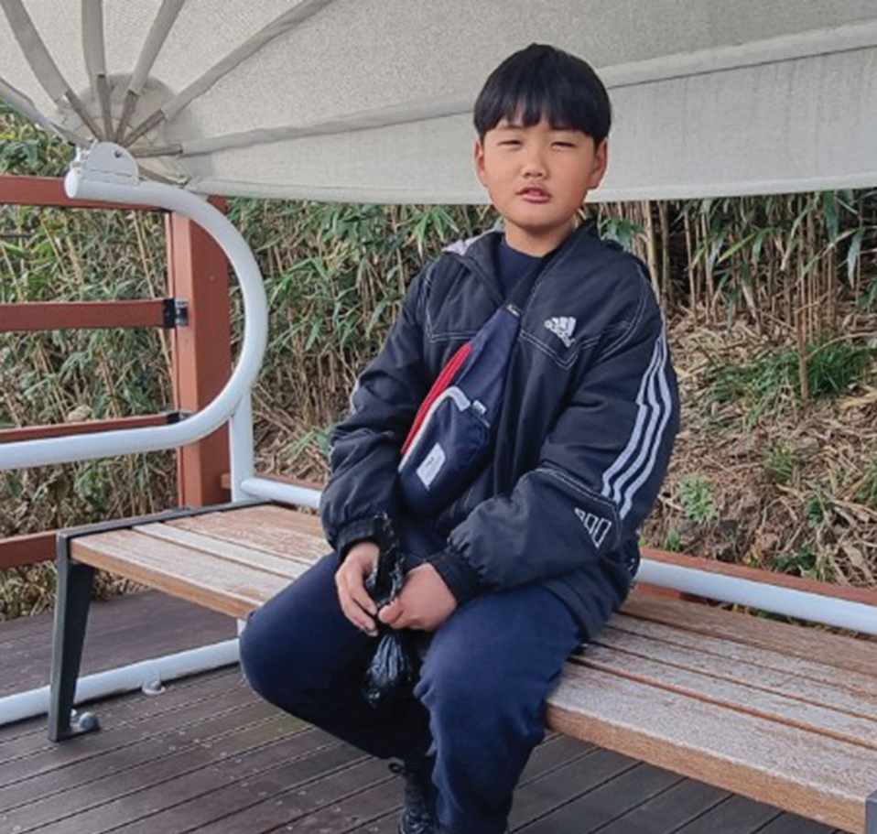
Week 7
SOUTH KOREA
February 15
Who Dressed First?
Tae-Hyung

Slide 30
Eleven-year-old Tae-Hyung likes school, and he likes to get good grades in South Korea. But to get good grades, he has to know the correct answers. To know the correct answers, he carefully does all of his schoolwork.
One day, the teacher asked the children a hard question. “When did human beings start to wear clothes?” she asked.
Tae-Hyung’s hand shot up.
“I know!” he said.
“What is the right answer?” the teacher said. “When did human beings start to wear clothes?”
“When Adam and Eve sinned,” the boy said, confidently. “God gave them clothes made from animal skin.”
The teacher looked surprised. That was not the answer that she was expecting. The school textbook didn’t mention Adam or Eve. It also said didn’t mention sin or God.
The boy saw the startled expression on his teacher’s face. He knew that his answer did not come from the textbook. He had read the textbook. But he also had read the Bible at an afterschool program at the Seventh-day Adventist church. He believed that the Bible was more correct than his textbook. He spoke up again. “The Bible says God gave clothes to Adam and Eve when they sinned,” he said.
The teacher wasn’t sure what to say. For a long moment she looked at the other children. Then she looked at

Slide 31
Tae-Hyung. She refused to accept his answer as correct.
“There are many odd stories in the Bible,” she said. “Could someone else answer the question? When did human beings start to wear clothes?”
Another child raised his hand and provided the answer from the textbook. He said human beings began to wear clothes 170,000 years ago.
After school, Tae-Hyung went as usual to the Adventist church to participate in the afterschool program. He and many of the 45 children in the program did not come from Christian homes, but their parents were happy that they could learn about the Bible.
Tae-Hyung’s favorite part of the program was a Bible club with a teacher named Mr. Cho. In the club, Tae-Hyung had read in the Bible that God created a perfect world and everything in it, including Adam and Eve.
He had read that sin entered the perfect world when Adam and Eve disobeyed God by eating forbidden fruit. He had read that Adam and Eve tried to cover themselves with fig leaves and then God gave them the first clothing. Genesis 3:21 says, “The Lord God made garments of skin for Adam and his wife and clothed them” (NIV).
That day, Tae-Hyung told the Bible club about what had happened at school. All of the other children agreed that he had given the correct answer. They expressed sadness that the schoolteacher had refused to accept his answer, and they said that she should have agreed with him.

Slide 32
The Bible club teacher was very proud of Tae-Hyung. By sharing the Bible in class, the boy had shown his faith that the Bible is the Word of God and that its stories are true. He had given the correct answer in front of his classmates and schoolteacher — and maybe one day they also would believe that the Bible has all the correct answers.
Pray for Tae-Hyung, his classmates, and schoolteacher to know God better. Pray for millions of people in South Korea and the rest of the Northern Asia-Pacific Division to know the correct answer about when human beings started to wear clothes. Part of your Thirteenth Sabbath Offering this quarter will go to 14 after-school programs similar to TaeHyung’s in Japan. Thank you for planning a generous offering on March 29.
By Andrew McChesney

Slide 33
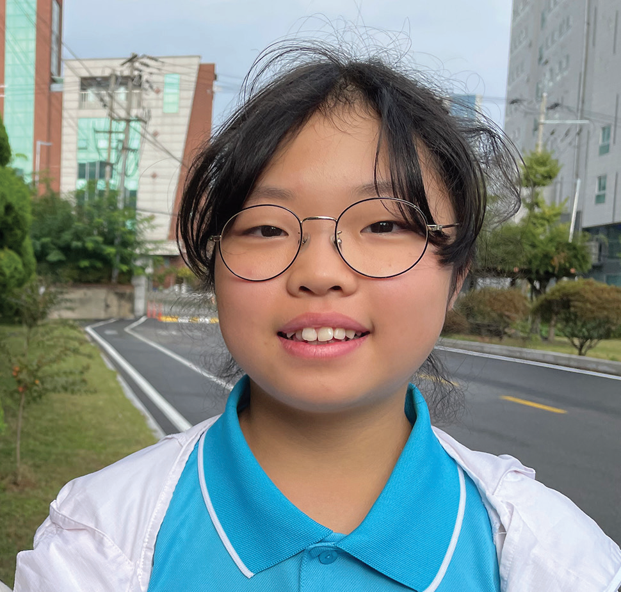
Week 8
SOUTH KOREA
February 22
A Persistent
Girl
Ee-un

Slide 34
Ee-un [EE-oo-yen] was happy when she learned that a fun Bible club would open at her church every day after school in South Korea. She loved Jesus, and she wanted her friends to love Jesus, too. But she felt kind of shy. What if she invited them to the Bible club and they said no? What if they refused to come?
Ee-un prayed for courage and then thought about who she would invite to the Bible club. It was hard to choose one or two children. She wanted everyone in her class to love Jesus. So, she asked all of her classmates.
“Can you join us?” she said. “Can you come at least one time? You can come at least one time, can’t you?”
But Korean schoolchildren are very busy. One girl said she had to help her mother after school. Another said she had too much homework. A third said she had music lessons.
Ee-un prayed, “Please, Lord, bring one of my classmates to the Bible club.” Then she kept inviting her classmates, even those who said they were too busy to come.
“Can you join us?” she said. “Can you come at least one time? You can come at least one time, can’t you?”
Then a girl accepted her invitation! Saleng said she would go with Ee-un to the Bible club.
Ee-un was so happy! God had answered her prayer! When she came home, she excitedly told Mom.
But the next day at school, Saleng had bad news. She couldn’t go after all.

Slide 35
Ee-un felt sad. She had looked forward to going with Saleng. She had thought that God had answered her prayer. But she was not discouraged. She decided to keep on praying and to keep on inviting her classmates.
“Can you join us?” she said. “Can you come at least one time? You can come at least one time, can’t you?”
Then another girl accepted her invitation! Jeong-yeon said she would go with Ee-un to the Bible club. But she said that she could not go every day.
“I can go with you on Fridays and Sundays,” she said.
Ee-un was so happy! But she wondered if Jeong-yeon would change her mind. She prayed for her to come.
On Friday afternoon, Ee-un saw Jeong-yeon walk into the Seventh-day Adventist church to attend the Bible club. She was overjoyed!
Jeong-yeon said her mom had given her a ride to church.
“I really wanted to come,” she said. “I begged my mom, ‘I want to go. Please, let me go.”
That day, Ee-un and Jeong-yeon enjoyed learning about Jesus from the Bible.
On Sunday afternoon, Jeong-yeon came to the Bible club again. Ee-un was so happy to see her. Again, the two girls

Slide 36
enjoyed learning about Jesus from the Bible.
Ee-un saw that it was important to keep inviting her classmates to the Bible club. The Bible says, “Let us not become weary in doing good, for at the proper time we will reap a harvest if we do not give up” (Galatians 6:9, NIV). Ee-un didn’t give up, and finally a girl accepted her invitation and came to the Bible club.
However, Jeong-yeon didn’t come the next Friday. Ee-un wondered what had happened. Jeong-yeon also didn’t come on Sunday afternoon.
At school on Monday, Ee-un found out that Jeong-yeon had moved to another part of South Korea. She lived so far away that she could no longer come to the Bible club.
Ee-un hopes that Jeong-yeon will learn to love Jesus even though she only came to the Bible club two times.
“I hope that she will believe in Jesus,” she said. “I hope to meet her in heaven.” In the meantime, Ee-un will keep inviting her classmates to come to the Bible club.
Pray for Jeong-yeon and all of Ee-un’s classmates to love Jesus. Part of your Thirteenth Sabbath Offering this quarter will go to two projects in South Korea that will help many people to know and love Jesus. Thank you for planning a generous offering on March 29.
By Andrew McChesney

Slide 37
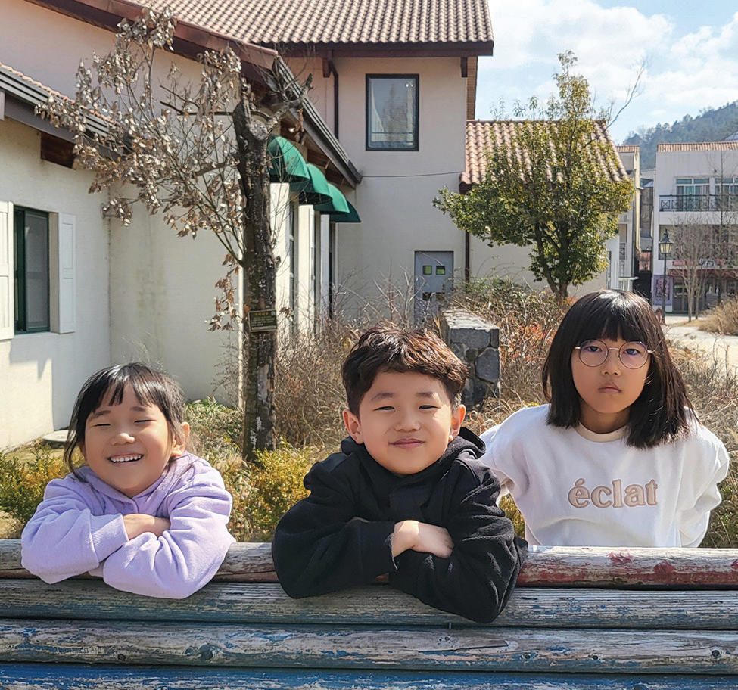
Week 9
SOUTH KOREA
March 1
Getting to
Know God
Sion, Chea-Hwan, & Ye-rim

Slide 38
Two little girls and their brother had never gone to church in South Korea. Their dad didn’t know God. Their mom didn’t know God. So, the children didn’t know God. But their auntie knew God, and she wanted the whole family to go to church.
The children heard Auntie call Dad on the phone. “Come to church with me on Sabbath, and bring Mom and the kids,” Auntie said.
“I don’t believe in God anymore,” Dad replied. “Some Christian kids were mean to me in school.”
The children weren’t sure about what had happened to Dad when he was a boy. But they knew that he had gone to a Seventh-day Adventist school and that something bad had happened to him.
Auntie didn’t give up. She really wanted Dad, Mom, and their three children to go to church.
“I think that the kids who were mean to you didn’t know God,” she said. “That is why they were mean. But if they had known God, they would have been different.
“You also would be different today if you knew God,” Auntie said. “If you had faith and went to church, you could teach your children to be kind to other kids and not be mean like those kids at your school. I want you to come to church with me.”
Dad, however, stood firm. “I don’t want to go to church anymore,” he said. “But if you insist on asking me, you can

Slide 39
take my kids to church.”
The three children looked at each other with excitement. They loved Auntie, and they were eager to go to church with her.
Auntie picked up the children on Sabbath morning. The two girls, 10-year-old Ye-rim [YEH heh-REEM] and 7-year-old Sion, [see-ON] and their 6-year-old brother, Chea-Hwan, [CHEE-ah HWAHN] had never been to church before, and they loved it! They learned happy songs, they listened to interesting stories, and they learned to pray to God.
The three children loved church so much that they told their friends about it. Then their friends also wanted to go to church on Sabbath. Before long, the three children were bringing eight friends to church every Sabbath. Auntie didn’t have enough room in her car for all of them, so she asked Mom if she could help drive children in her car. Mom agreed, and so it was that Mom also started to go to church every Sabbath.
One Sabbath, Auntie learned that the children were praying to God on their own at home. They prayed when they woke up in the morning, saying, “We thank You, God, for giving us this day and for giving us good health.” At night, when they went to bed, they prayed, “Thank You, God, for giving us a great day.” Auntie was so happy! The children who had not known God were now praying to Him every day.
When Mom saw the children praying, she began to think more about God.
Auntie asked her, “Can we study the Bible together?”

Slide 40
“Yes,” Mom said.
So, Mom and Auntie started studying the Bible together. Then Mom began opening the Bible at home and teaching her children about God. She even helped lead out in the children’s activities at church.
Before long, Dad changed his mind about God. While he still didn’t want to go to church on Sabbath, he was happy that Mom and the children were going. Their life had become a lot happier ever since the children and Mom had started to get to know God.
Pray for Dad and the rest of the family as they get to know God better. Part of your Thirteenth Sabbath Offering this quarter will go to two projects in South Korea that will help many people get to know God better. Thank you for planning a generous offering on March 29.
By Andrew McChesney

Slide 41
Week 10
SOUTH KOREA
March 8
Bugs, Lizards
And Cats
Haon and Sion

Slide 42
Five-year-old Haon [HA-on] and 4-year-old Sion [see-ON] were two sisters living in South Korea. They loved playing with their 5-year-old neighbor friend, a girl named Jooyoung. [ZOO-young] When the three little girls got together, they had big adventures.
Now some girls might be scared of insects and lizards. But not these girls. They had no fear of any creature, big or small.
One of the girls’ favorite activities was catching flies and bugs and putting them into a jar. All around their apartment building they went, hunting high and low for flies and bugs.
When Haon, Sion, and Jooyoung had caught enough flies and bugs, they looked for a lizard. All around their apartment building they went, hunting high and low for a lizard.
What do you think that the girls did when they captured a lizard? They fed it a delicious meal of flies and bugs, of course! Then they released the lizard to resume its interrupted journey across an apartment building wall.
Haon and Sion would have liked to bring the lizard and the flies and bugs into their apartment. But Mom wouldn’t let them. She said lizards, flies, and bugs belonged outdoors.
Mom also said cats belonged outdoors. Several stray cats with no home lived in the garden outside the apartment building. Haon, Sion, and Jooyoung enjoyed petting them, talking to them, and feeding them.

Slide 43
What do you think that the girls fed the stray cats? No, not lizards or flies or bugs! They fed the cats tuna that Mom gave them from a can, of course.
Mom didn’t allow flies, bugs, lizards, and stray cats in the apartment. But she did make an exception for a baby bird. Once, the girls found a baby sparrow that was shivering with cold after falling out of its mother’s nest. Mom allowed the girls to bring it into the apartment to warm up in a box. Then they returned the baby sparrow to its mother.
Haon, Sion, and Jooyoung were the best of friends. They loved to play, and they loved animals. But they had one big difference. Haon and Sion also loved Jesus, but Jooyoung had never heard of Jesus. Haon and Sion were waiting for Jesus to come and take His children to heaven. Jooyoung had never heard that Jesus would come and take people to heaven. Haon and Sion wanted their friend to know and love Jesus. They began praying every night for her and her family to know Him. The girls couldn’t bear the thought of not playing with their dear friend in heaven.
Then the girls grew older and started to go to school. They didn’t have as much time to play. One Sabbath morning, Jooyoung knocked on her friends’ door.
“Can we play at your place today?” she asked.
“We can’t play here today because we are going to church,” Haon said.
“It would be great if we could go together to church,” Sion said.

Slide 44
Jooyoung couldn’t go that day. But she kept coming over on Sabbath mornings, and her friends kept inviting her to church. One Sabbath morning, she agreed to go to church. Haon and Sion were overjoyed! It was an answer to their prayers. They had prayed every night for two years for Jooyoung to know Jesus.
Today, Haon is 13, and Sion is 12. Jooyoung is 13, and she has been going to church with them every Sabbath for six years. The girls are also Pathfinders, and they look forward to playing with insects, lizards, and cats in heaven one day.
Pray for Jooyoung’s family to also know Jesus. Part of your Thirteenth Sabbath Offering this quarter will go to two projects in South Korea that will help people to know Jesus. Thank you for planning a generous offering on March 29.
By Andrew McChesney

Slide 45
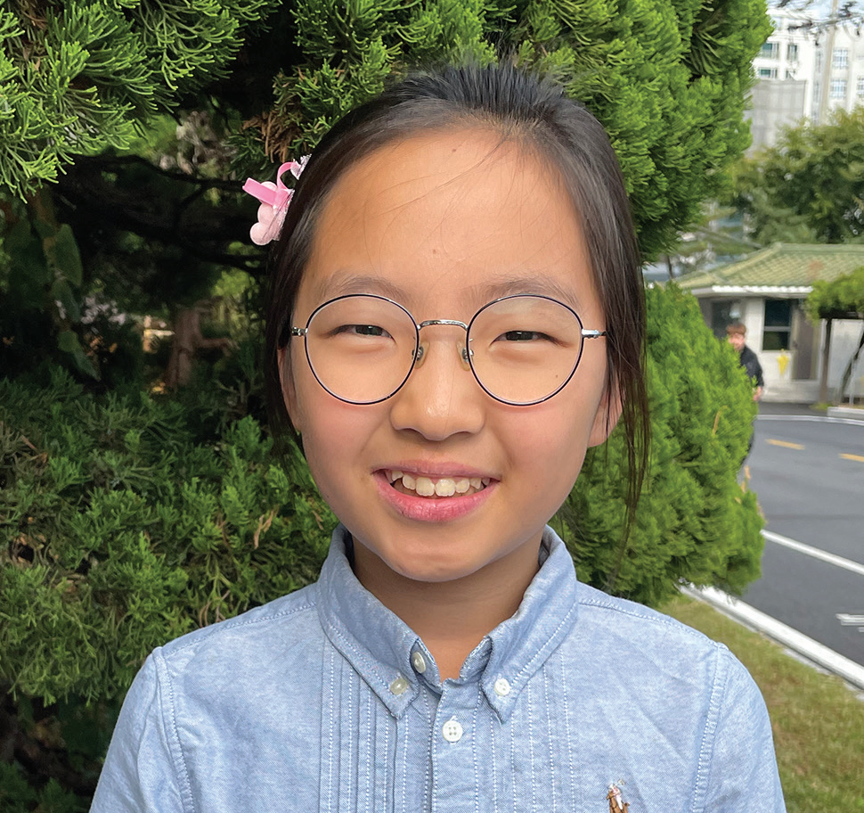
Week 11
SOUTH KOREA
March 15
Not Giving Up
Onyu

Slide 46
Ten-year-old Onyu [o-nyu] is outgoing, and she likes to talk with friends at school. When she learned that her church was planning a Vacation Bible School, she was excited that she would have something new to talk about with her friends. She could invite them to the Vacation Bible School.
Onyu goes to a Seventh-day Adventist school in South Korea. But many of her classmates come from families who do not believe in God.
So, at school lunchtime, Onyu stood up in front of all her classmates. She spoke up loudly so everyone could hear her.
“Is anyone interested in coming to my church?” she said. “We will have a good Vacation Bible School on Friday, Saturday, and Sunday. Do you have time?”
In her hand, she held four colorful fans that she had made. On each fan, she had written a personal invitation to the Vacation Bible School. She wanted to give the fans to anyone who wanted to go.
Many children said that they couldn’t go. They had to do homework, help with chores, or do other things.
But Onyu didn’t give up.
“Please come,” she said. “We are going to the swimming pool on Sunday. I would like you to go with me.”
Then two girls and a boy said that they would like to go. Onyu gave fans to each of them.

Slide 47
The next day, one of the girls said that she couldn’t go. Her parents had told her that she was too busy. But the other girl and the boy said that their parents had given them permission to go.
Onyu was so excited! She smiled as bright at the sun.
But a few days later, the girl said that her mom had changed her mind. She couldn’t go after all.
Onyu was sad, but she was happy that at least one classmate, the boy, would be able to attend. His name was Jisung. [jee sung]
On the first day of the Vacation Bible School, Onyu eagerly looked around for Jisung.
“Where is here?” she thought.
She waited and waited and began to grow worried.
“Why isn’t he coming?” she wondered.
Jisung didn’t come on Friday.
The next day, on Saturday, Onyu couldn’t check to see if he was there because she was sick at home.

Slide 48
But Jisung showed up at the swimming pool on Sunday.
Onyu was overjoyed when she saw him!
Jisung was also thrilled to be there, and he enjoyed every moment of the day. Like Onyu, Jisung was also outgoing, and he liked to talk with friends at school.
At school on Monday, he excitedly told everyone about the Vacation Bible School and about all of the fun that he had had. He was so excited! He wanted to go back again.
“When is the next Vacation Bible School?” he asked Onyu. “I’ll tell everyone about it, and I’ll definitely go again.”
He also said that he wanted to go to church with Onyu on Sabbath.
That night, Onyu offered a prayer of gratitude to God.
“Thank You, God, for using me as Your instrument for mission,” she prayed.
Onyu goes to Hankook Sahmyook Academy in Seoul, South Korea. Part of this quarter’s Thirteenth Sabbath Offering will help the school open a gym and missionary training center. Thank you for planning a generous offering on March 29.
By Andrew McChesney

Slide 49
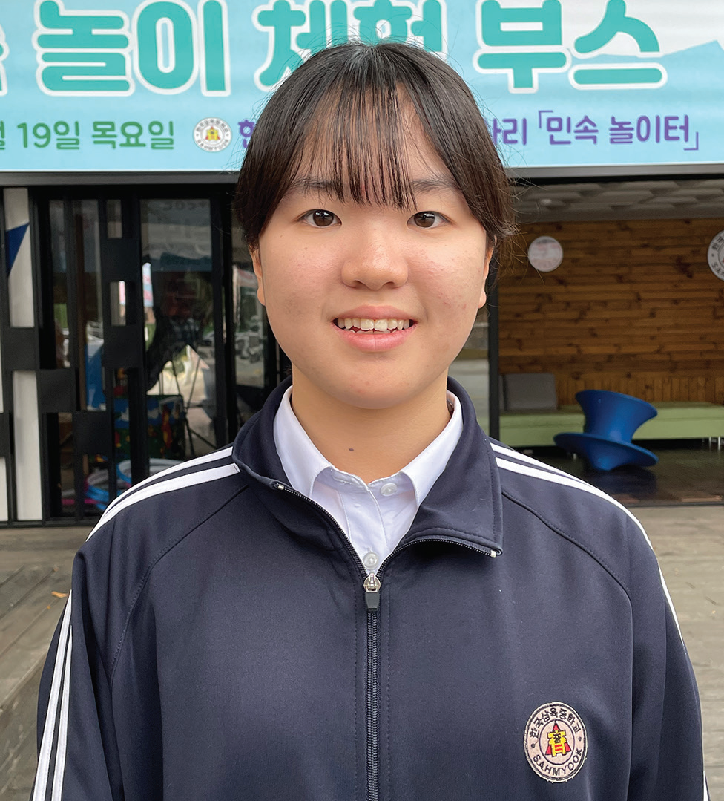
Week 12
SOUTH KOREA
March 22
“I Don’t
Eat Pork”
Yeseo

Slide 50
Schoolchildren teased Yeseo [YE-syo] for as long as she can remember. They didn’t tease her because of the way she looked. They didn’t tease her because of the clothes that she wore. They teased her because of the food that she ate.
Yeseo went to public school in South Korea. She was the only Seventh-day Adventist at the school.
Before leaving school every day, Yeseo looked at the school’s lunch menu to see what food would be served the next day in the school cafeteria. She needed to know if she could eat the school’s lunch or if Mom should pack her a special meal.
One day, she saw that lunch would be black-bean noodles with pork and yellow radish. When she got home, she told Mom, and Mom prepared her a lunch of fried rice with mixed vegetables and kimchi.
The school didn’t allow children to bring food from home for lunch. It was against the school rules. So, when Yeseo took out her fried rice and mixed vegetables at lunch, the other children looked at her strangely.
“Are you sick?” asked one.
“Do you have a problem?” said another. “Why did you bring a lunch?”
“I’m Seventh-day Adventist,” Yeseo said. “I don’t eat pork.”
“What is a Seventh-day Adventist?” a girl asked.

Slide 51
“It is a church that believes in God,” Yeseo said.
That was the easiest way that she could explain it. Many of her classmates did not come from Christian homes and did not believe in God.
The next day, the school cafeteria served vegetables and pork cutlets with sheets of roasted seaweed. The pork wasn’t mixed with the other food, so a teacher gave Yeseo extra vegetables and seaweed but no pork.
The children again looked at Yeseo strangely. “Why are you special?” said one. “What makes you so special?”
“You aren’t special,” said another. “So, why do you get extra food?”
“It’s because I’m a Seventh-day Adventist,” Yeseo said. “God told me not to eat pork. I’m trying to obey Him.”
The children looked at Yeseo with odd expressions on their faces.
“Poor you,” said a boy.
“You have a hard life,” said a girl. “Why do live that way?”
“I’m fine,” Yeseo assured them. “I’m happy with my life. I have a happy life.”

Slide 52
With all the strange looks and curious questions, Yeseo felt like a total stranger at school. No one seemed to want to be her friend. She felt all alone.
One day, Yeseo brought her own lunch again because the cafeteria was serving pork. The children looked at her strangely as usual, and several teased her. She explained again that she was a Seventh-day Adventist.
Then one girl stopped teasing her and asked if she felt healthy even though she didn’t eat pork.
Yeseo replied that she felt good because she ate only good food. She invited the girl to do the same.
The girl was curious to know more. “Can I come to church with you?” she asked.
After that, the two girls went to church together every Sabbath. Yeseo was so happy! She had a new friend, and she had made the friend simply by obeying God.
Today, Yeseo is happy to no longer have problems with food at school. When she started high school, she moved to an Adventist school, Hankook Sahmyook Academy, in Seoul, South Korea. Part of next Sabbath’s Thirteenth Sabbath Offering will help his school open a gym and missionary training center. Thank you for planning a generous offering next Sabbath.
By Andrew McChesney

Slide 53
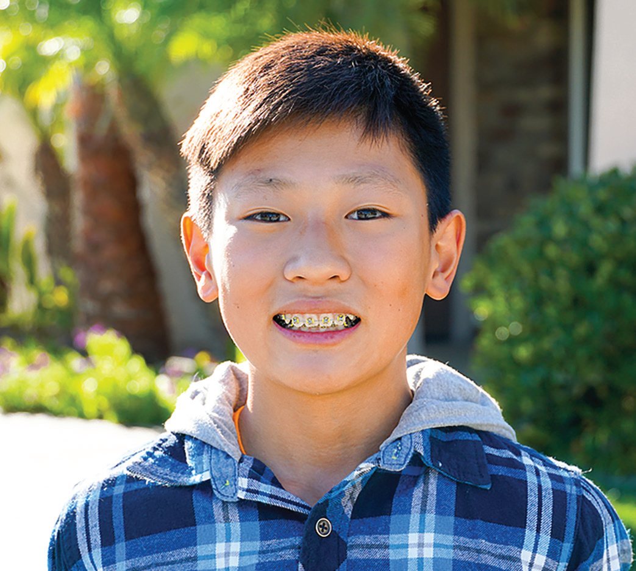
Week 13
13th Sabbath
SOUTH KOREA
March 29
Hard Bible
Test
Joon-woo

Slide 54
Twelve-year-old Joon-woo [JOON-woo] didn’t belong to a Christian family. He had never read the Bible. But he knew more than anything that he wanted to go to a Seventh-day Adventist school in Seoul, South Korea.
Many children wanted to go to the Adventist school because it had a good reputation. Joon-woo and every other child who wanted to study at the school had to pass a special entrance exam. For the exam, Joonwoo would have to sit down with a teacher and answer questions about math, science, and English. He also would have to answer questions about the Bible.
Joon-woo wasn’t worried about being tested on math, science, and English. He was a bright boy, and he knew that he could ace those questions. But the Bible? He wasn’t so sure about that. How could he answer Bible questions without knowing the Bible?
Joon-woo’s mom also wanted him to go to the Adventist school. She had heard about it from an Adventist mom whose son went there. Mom asked the Adventist mom for help. “How can my son pass the Bible part of the entrance exam?” she asked.
The Adventist mom had an idea.
“The best way to pass the exam is to go to an Adventist church every Saturday and learn the Bible,” she said.
So, Joon-woo and Mom showed up at an Adventist church on Sabbath. Joon-woo wasn’t the only child from a non-

Slide 55
Christian family who came to church that Sabbath. Five other boys and girls came with their moms because they also
wanted to learn the Bible so they could go to the Adventist school.
Everything about the church was unusual and strange to Joon-woo. He didn’t understand many of the words that he heard from the Bible. He didn’t get along well with the other children. But because he wanted to study at the Adventist school, he came back to church the next Sabbath and then the next. During Sabbath School, he studied the Bible with other children who also wanted to go to the Adventist school.
Joon-woo was silent during Sabbath School. His face didn’t show any expression. It was impossible to know whether he liked Sabbath School or didn’t like Sabbath School. But he came every Sabbath for four months. The other five children from non-Christian families also came for four months.
Then the day of the big entrance exam arrived. Joon-woo easily answered the questions about math, science, and English. He wondered if he could answer the Bible questions.
Then the teacher asked, “Which of God’s commandment is about keeping the Sabbath?”
Joon-woo remembered learning the Ten Commandments in Sabbath School, and he answered, “The fourth commandment.”
“Correct!” the teacher said.

Slide 56
The next question was more difficult. “Who did Philip baptize?” the teacher asked.
Joon-woo remembered reading in the Bible about Philip being sent by an angel to meet with a man on the road between Jerusalem to Gaza.
“An Ethiopian eunuch who was treasurer of the queen of the Ethiopians,” Joon-woo said.
“Correct!” the teacher said.
The next question was, “What happens to people when they die?”
That was a tough one. But Joon-woo remembered reading in the Bible that the dead will sleep in the ground until Jesus wakes them with a loud shout at the Second Coming.
“They wait in their graves until Jesus comes to resurrect them,” he said.
Joon-woo passed the entrance exam. The other five children also passed it, and all of them entered the Adventist school.
Joon-woo and the other five children stopped going to church on Sabbath. They no longer needed to study the Bible for the entrance exam, and they found other things that they wanted to do. But one of their moms kept going to church.

Slide 57
She gave her heart to Jesus and was baptized.
After a while, however, Joon-woo started to miss Sabbath School. He went back to church from time to time. Then he
began to go every Sabbath again.
Today, Joon-woo is 15 and he loves to go to church every Sabbath. He loves studying at the Adventist school. More than anything, he wants to become a pastor when he grows up.
Pray for Joon-woo to become a missionary for God. Joon-woo goes to Hankook Sahmyook Academy in Seoul, South Korea. Part of today’s Thirteenth Sabbath Offering will help his school open a gym and missionary training center. Today’s offering Future Thirteenth Sabbath Projects will also support four other important projects in the Northern Asia-Pacific Division, including a shelter for single mothers in Ansan, South Korea; after-school centers at 14 schools in Japan; a children’s recreation center in Ulaanbaatar, Mongolia; and the establishment of an Adventist elementary school system in Taiwan.
By Andrew McChesney

Slide 58
